Slide 1
Biobank Dashboard
Implementation
Ayda Zamanian

Slide 2
Biobank dashboard vs LIMS
LIMS focuses on sample management, data organization, and workflow automation, while biobank dashboards provide a user-friendly interface for accessing and analyzing the data stored in the LIMS.
Biobank softwares:
TDBioBank by TECHNIDATA - LIMS
BiobankPro by Azenta Life Sciences - Biobank Dashboard
OpenSpecimen - Biobank Dashboard
Labvantage Biobanking - LIMS
Bika LIMS - LIMS
Open LIMS - LIMS
Molgenis - Biobank Dashboard
caTissue Suite - Biobank Dashboard

Slide 3
Languages used
it is common for biobanking software and LIMS systems to utilize relational databases such as MySQL, Oracle, or SQL Server, which commonly use SQL (Structured Query Language) for querying and manipulating data
web services, REST, and R-project. This suggests that Molgenis interacts with databases and likely uses a database language like SQL.
Open LIMS is implemented in PHP, which imples the use of a database language compatible with PHP, such as MySQL or PostgreSQL.

Slide 4
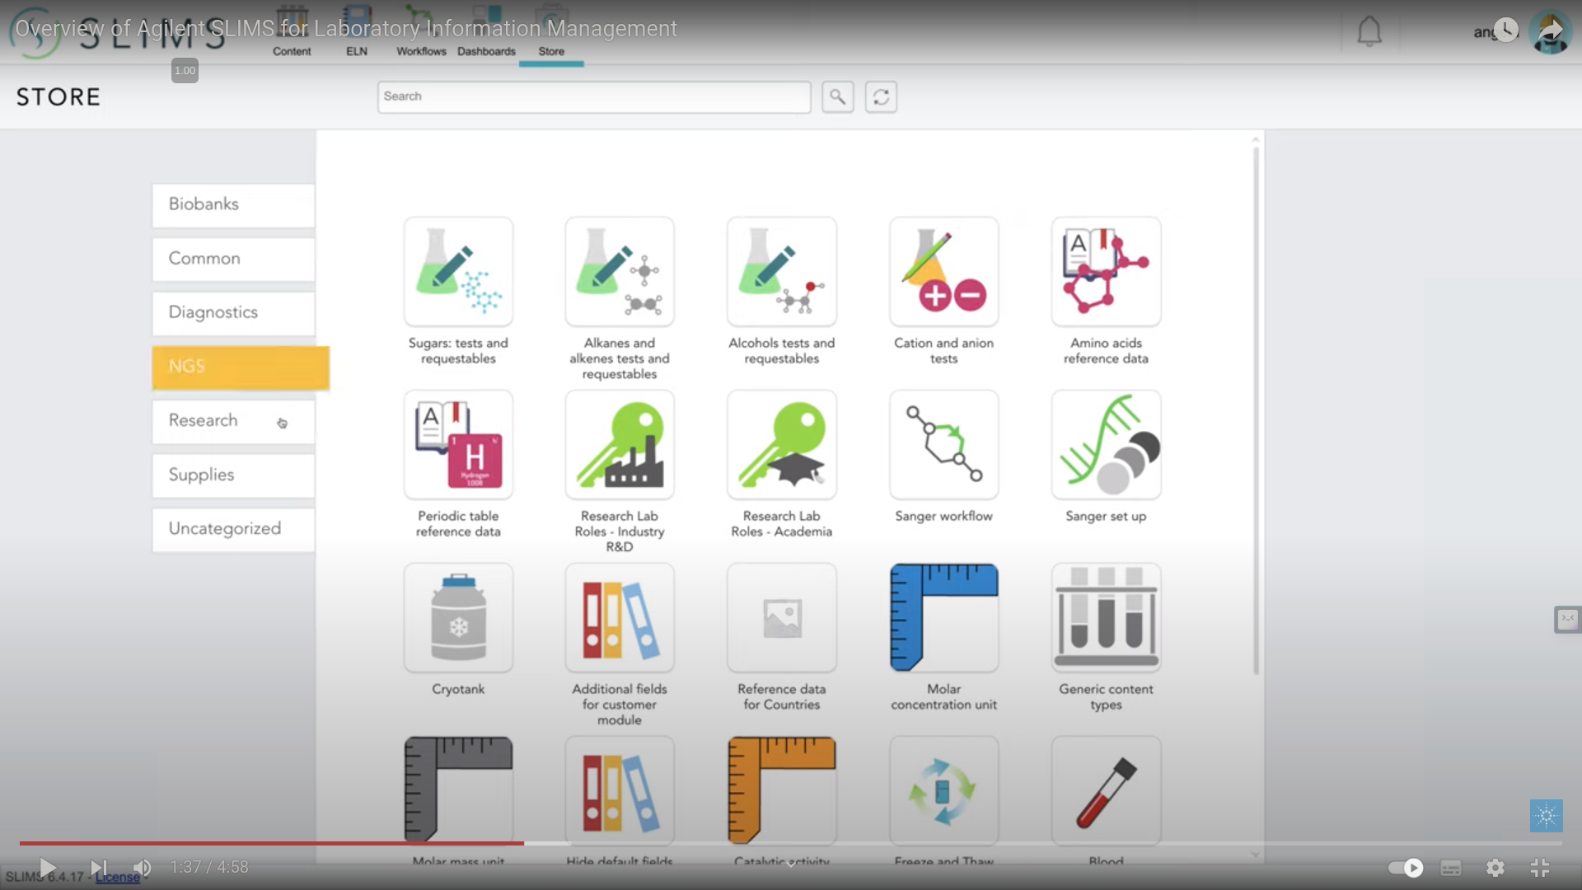

Slide 5
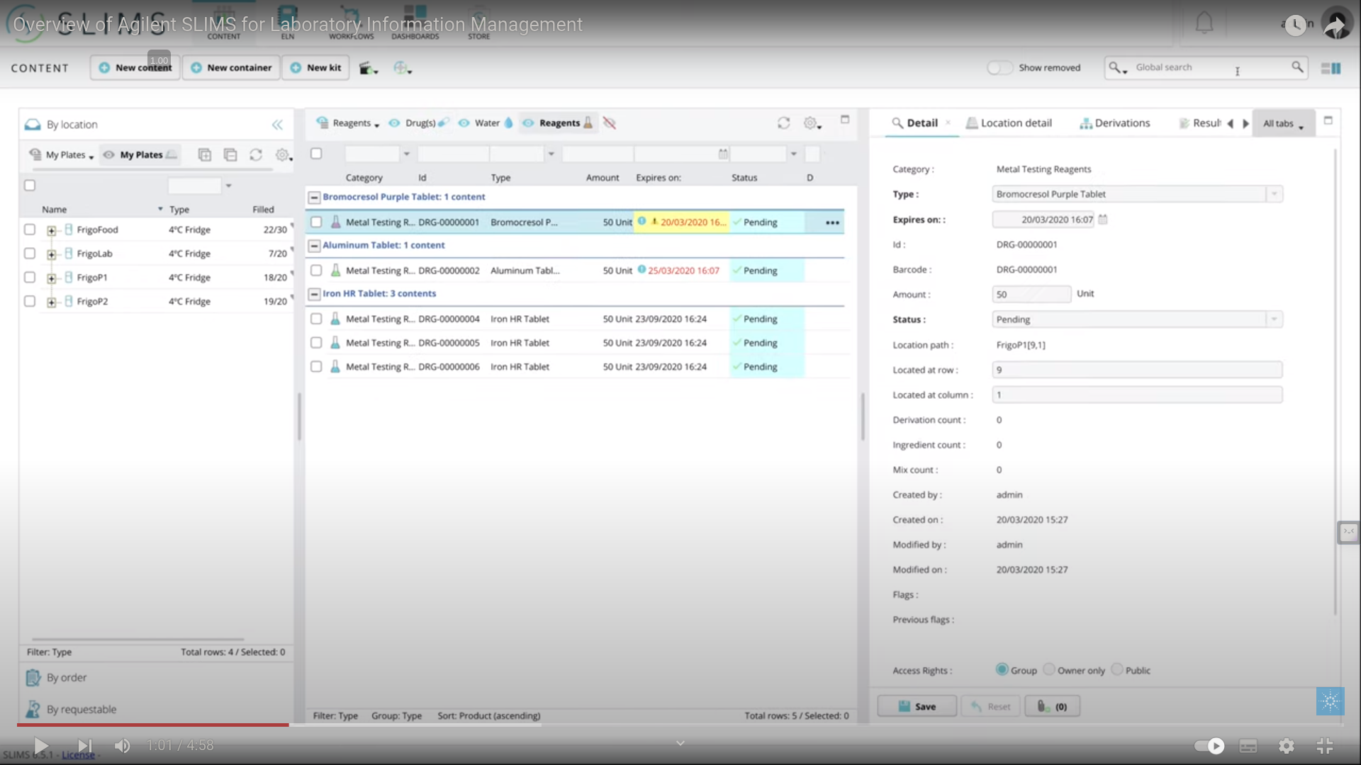
Vidoe link

Slide 6
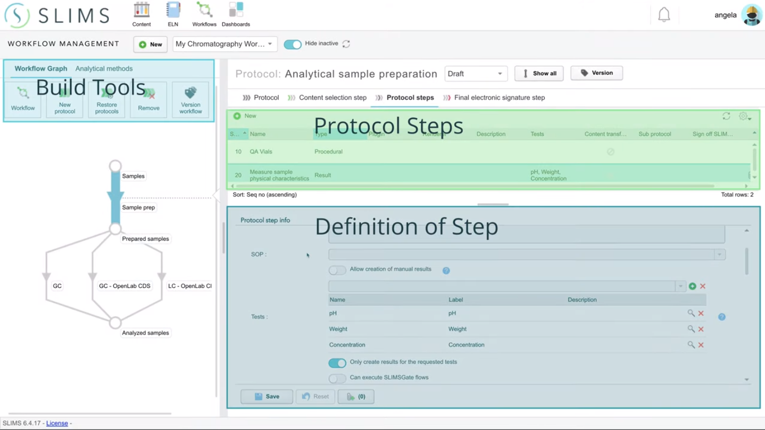

Slide 7
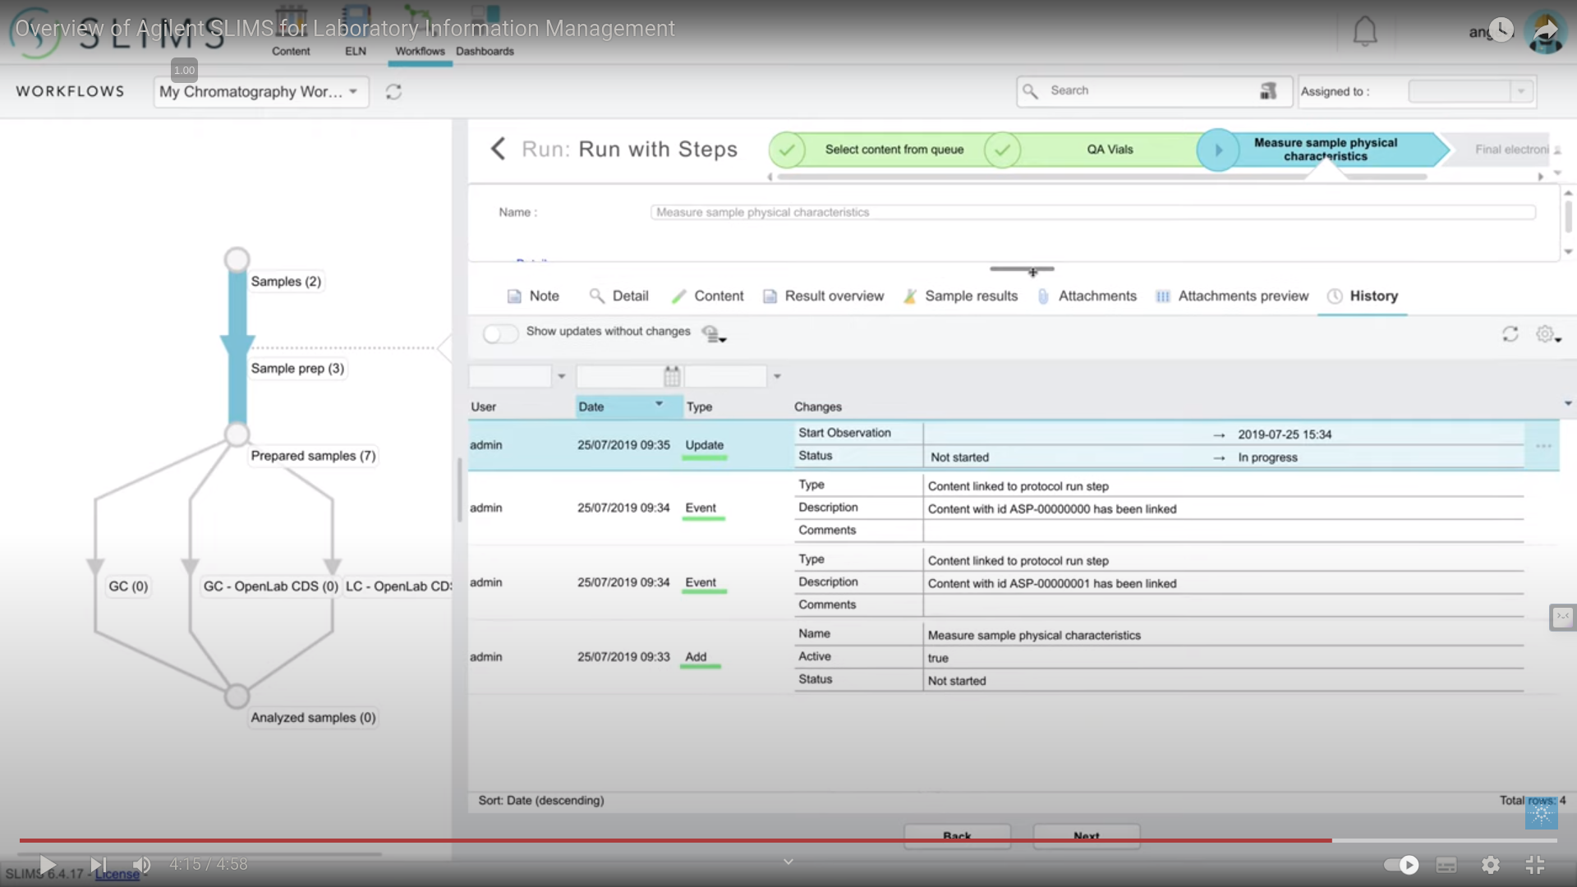

Slide 8
Evaluating a data management system for a biobank
Customizable datafields: The system should allow you to capture any data elements and data fields relevant to your samples.
Comprehensive location information: support recording highly specific location information for every sample including details such as storage location, temperature, and other relevant information.
Bulk sample record management: creating and updating sample records in bulk, especially when dealing with a large number of samples
History tracking: The system should automatically record the history of any changes made to sample information. This allows for tracking and auditing changes, ensuring the accuracy of data, and meeting regulatory requirements.
Advanced search and filtering capabilities: having powerful search and filtering functionalities to easily identify specific samples based on various criteria.

Slide 9
interactive data visualization software, Customize and Enhance Visualizations
Tableau (free source: tableau public) :data visualization software that helps users interact with and analyze data in a visual and intuitive way. It allows users to create interactive dashboards, reports, and visualizations by connecting to various data sources such as spreadsheets, databases, and cloud services.
InfluxDB Cloud: InfluxDB is a time-series database designed specifically for handling high volumes of timestamped data. It is an open-source database that is written in Go and built for storing and retrieving time-series data efficiently. You can visualize data with the InfluxDB UI
Grafana: a multi-platform open source analytics and interactive visualization web application. It provides charts, graphs, and alerts for the web when connected to supported data sources

Slide 10
Refrences
Vidoe link
https://www.ncbi.nlm.nih.gov/pmc/articles/PMC4696440/
https://public.tableau.com/app/discover
https://github.com/krishagni/openspecimen
https://github.com/open-lims/open-lims
https://www.molgenis.org/features.html

